Slide 1
Credit and Loans
BEFORE PRESENTING THIS MATERIAL:
PRACTICE THE PRESENTATION FOR TIMING
REVIEW PRESENTER NOTES TO BECOME FAMILIAR WITH THE INFO / SLIDES
PUT PRESENTATION INTO ‘SLIDE SHOW’ MODE TO CLICK THROUGH THE PRESENTATION AND USE THE INTERACTIVE ELEMENTS.
DELETE THIS MESSAGE BEFORE PRESENTING.
Notes:
LESSON CONCEPT – Learning about Credit and Loans
LESSON OBJECTIVE – Participants learn about credit, credit cards, loans and credit scores / reports.
MATERIALS NEEDED
For you:
Internet Access
Projector
PowerPoint Presentation
Participant
Tablet / Computer with Internet Access (optional)
Handouts
INTRODUCTION
Introduce yourself and share with the class what you’ll be covering today:
Understanding about what credit is
Learn about loans
Learn about credit scores / reports
Have fun!
Any questions before we begin?

Slide 2
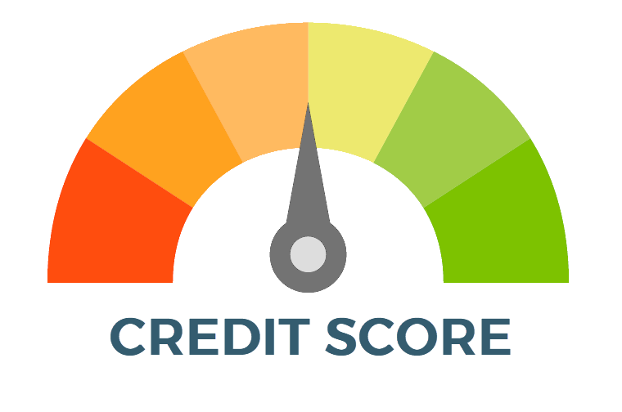
Credit – Keeping Promises
Have you ever borrowed money from someone?
What kind of agreement did you make with them about paying the money back?
Has anyone ever borrowed money from you and didn’t pay you back?
Notes:
Start the lesson with the following opening questions:
How do you know if someone will keep a promise? If someone were to break a promise, how would you feel the next time they make a promise?
Have you ever borrowed money from someone? What kind of agreement did you make with them about paying the money back?
Encourage the participants to share their answers.

Slide 3
Video – What is Credit?
Notes:
CLICK THE VIDEO TO PLAY THE ‘WHAT IS CREDIT?’ VIDEO. TO PAUSE, CLICK THE VIDEO AGAIN.
Talking points for the class:
-Clarify what a Lender is. It could be a Bank, Credit Card or Mortgage company. There are different types of lenders.
-If you do a careful job of managing your money over time, you’ll gain the ability to borrow money when you need it.
-This ability to borrow money is called having credit.
Share the following key points to help students understand the importance of credit and interest:
Credit refers to the ability of a person or a business to borrow money from a lender with the intent or promise to pay the money back, usually with interest.
To earn credit, you first have to show lenders that you’re a good money manager.
When you borrow money from a parent, guardian, neighbor, or friend, you usually promise to pay it back by a certain time. They lend you the money because they trust you to keep your promise.

Slide 4
Four C’s of Credit
CREDIT HISTORY
Lenders want to see a history of stability - for example, how long have you lived at your current address, how long have you been at your current job, do you have a history of paying your debts on time.
COLLATERAL
Assets of a borrower (for example, a home) that the lender has the right to take ownership of and use to pay the debt if the borrower is not able to make the loan payments as agreed.
CONDITIONS
Lenders might consider outside circumstances that may affect the borrower’s financial situation and ability to repay (for example, what’s happening in the local economy).
CAPACITY
Your other debts and expenses could impact your ability to repay the loan. Creditors evaluate your debt-to-income ratio, that is, how much you owe compared to how much you earn.
Notes:
Go over the 4 C’s of credit with the participants. Ask if they have any questions.

Slide 5
Where Can I Get Credit?
Banks and credit unions
Credit Cards (e.g. Visa, MasterCard, Amex)
Department stores (e.g. Target, Walmart, Costco, Best Buy)
Car dealerships
Loans / Student loans
Stores (furniture/electronics)
Tip: If you’re just starting out, you may want to consider opening a secured credit card or loan, gas card, or retail store charge card to begin establishing your credit history.
Notes:
Where can I get credit? How do I get credit?
Secured credit cards are often backed by a cash deposit so they’re easier to get even if you have bad or no credit. Your lender can keep the money if you fail to make payments on your credit card bill.
Retail cards and gas cards, typically approve consumers with lower credit scores and report to the credit bureaus so that cardholders who pay as agreed can build a positive credit history.
If you manage your secured credit cards, retail cards and/or gas cards responsibly you can use those to help you establish and improve your credit.

Slide 6
Responsible Credit Management
Responsible Credit Management Practices
Pay the outstanding balance or minimum amount every month Keeping credit card balances below 70% of the credit limit Paying on time Never missing a payment Staying within your credit limit ‘Freeze’ Your Credit to Protect Yourself¹
Results of Responsible Credit Management
Easier to borrow money No penalty fees More money in your pocket Potentially lower interest rates Low ratio of debt vs. income Ability to shop around
¹https://www.experian.com/freeze/center.html
Notes:
Review the Responsible Credit Management Practices first. Emphasize the 70 percent of your credit limit point. This shows that you can control your use of credit and also to leave enough credit available in case of an emergency.
Should You Freeze Your Credit Report?
Before adding a security freeze, you may instead consider requesting an initial fraud alert and a free credit report so that you can review it carefully. If there is no sign of fraud in your report, you might not need to take additional action.
If you froze your credit report and you or another party were to apply for new credit with a lender using your personal identification information, the lender would be unable to access your credit report when processing the application. https://www.experian.com/freeze/center.html

Slide 7
Credit History
Lenders find credit history and scores from the following credit agencies:
EQUIFAX
TRANSUNION
EXPERIAN
Credit Agencies Track
How much you owe
Whether you pay your bills on time
Different types and number of credit accounts you have
Where you live/work and how long you’ve lived/worked there
Notes:
Tell participants that the three main credit agencies for credit reports are Equifax, Transunion and Experian. Let them know what the companies track.

Slide 8
Video – Your Credit Score
Notes:
Watch the Your Credit Score video and have a discussion about it.

Slide 9
The Basics of Loans – Video
Notes:
Watch the video with participants to give a quick overview of what loans and borrowing are. Ask them what the difference is between loans and credit cards.

Slide 10
Loan Comparison
Compare Interest Rates
Now compare these two sample loans. Note how the interest rate affects the total amount of interest paid
Interest Rate Comparison
Loan amount of $10,000 with a 5 year term
ABOUT THE LOAN | LOAN A | LOAN B
INTEREST RATE | 5% | 15%
MONTHLY PAYMENT | $188.71 | $237.90
TOTAL INTEREST OVER 5 YEARS | $1,322.74 | $4,273.96
Note: Always try to get a loan with the lowest interest rate you can. A strong credit score may help you qualify for a lower interest rate.
Notes:
As for the interest rate, it’s important to shop around. Some lenders may give you a lower rate than others. In general, the shorter the term, the lower the interest rate.
By getting a 5% interest rate vs. 15%, this borrower would save almost $3,000 interest over five years!
Having more financial stability can lead to getting a lower interest rate. This means you’re more reliable in repaying your debt / credit card / loan.
NOTE - The final month’s loan payment may vary from the regular monthly payment.

Slide 11
Loan Warning Signs
False Information
Bank Loan Documents
Bait and Switch
Equity Stripping
Loan Flipping
Fees for Bi-Weekly Payments
Tip: If you’re just starting out, you may want to consider opening a secured credit card or loan, gas card, or retail store charge card to begin establishing your credit history.
Notes:
Talk about the warning signs of loans / lenders
FALSE INFORMATION – Encouragement to include false information. If a lender has changed any of your income or expenses information or leaves your income blank, don’t sign the application
BANK LOANS DOCUMENT – Never sign a bank loan document or work with a lender who asks you to.
BAIT AND SWITCH – When a lender makes promises in order to make the sale, but then backs out on the promises after the sale. Be sure to question anything in the document that is not consistent with what you were told.
EQUITY STRIPPING – A lender encourages you to inflate your income on your application for to get the loan approved.
LOAN FLIPPING – When a lender persuades a borrower to repeatedly refinance a loan.
FEES FOR BI-WEEKLY PAYMENTS – Some lenders will offer you the option to pay your loan bi-weekly. Although this can lower the finance charge, lenders may charge fees to have the privilege of having bi-weekly payments as an option

Slide 12
Quiz Time!
Q1: True or False – When I use my credit card to make a purchase I am borrowing money?
True
True
False
Q2: The term Interest Rate refers to:
a.
Amount of credit I have available on the card.
The interest rate set by the government for credit cards.
My annual fee for having this rewards card.
What is used to compute my finance charge.
b.
c.
d.
d.
Notes:
Presenter Notes/Comments:
Question 1
Ask the participants the first question. Give them time to answer. The correct answer is TRUE. Explain to participants that you are borrowing money from the credit card company when you use your card.
Question 2
The answer is D. This is the interest rate that is used to calculate the amount of interest to be charged on all or part of the balance if the full amount is not paid on or before the due date. The lower the APR means the lower the cost of the loan to you.

Slide 13
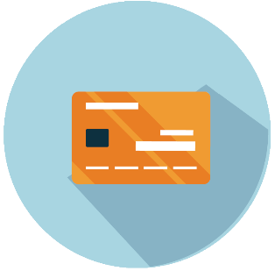
Wrap-up
Be smart about managing your credit
Shop for credit
Keep track of charges
Plan your shopping
Pay on time
Set limit and stick to them!
Get help early if you can’t meet your credit obligations
Be aware of credit trouble signs
Paying late
Ignoring savings
Bouncing checks
Maxing out credit
Experiencing stress over finances
Feeling like you’re paying forever
Notes:
Review how to be smart about managing your credit and some of the credit trouble signs.

Slide 14
Thank You

Slide 15
Handouts

Slide 16
Ten Tips for Credit Card Users
Pay on time. Ask your credit card issuer if it offers automatic payment options or email alerts to remind you when a payment is due.
Read your cardholder agreement—all of it. The agreement spells out fees and finance charges, so make sure you understand the terms. If you have questions, don’t hesitate to ask your card issuer’s customer service agent.
Learn the facts about finance charges. If you don’t pay the entire amount due within the grace period, you will be charged interest on the unpaid amount. Understanding how creditors calculate interest can help you to manage your costs. Make sure you know the Annual Percentage Rate (APR), Periodic Rate, and the method the creditor uses to calculate interest.
Know your credit limit. Monitor your account so you know how much available credit you have. Stay well below your limit in case you need to make an emergency purchase.
Create a budget and stick to it. Budgeting helps you keep control of your finances and resist spending sprees. If you plan ahead, you’ll know whether or not you can afford a particular purchase.
Reduce your debt. Keep your credit card balance low and don’t take on more debt than you can handle. This will also help your credit score.
Limit cash advances. These advances often incur higher fees and finance charges.
Applying for a new account? Think first. When a potential lender requests your credit report, an “inquiry” registers on your report. A high number of inquiries can negatively affect your credit score, so only apply for a new account when you really need it.
Prevent credit card fraud. Closely watch activity in your account. Many companies allow you to check your activity online at any time. Make sure that each transaction was made by you. If you notice suspicious activity, report it to your credit card issuer immediately.
Review your credit report. At www.annualcreditreport.com, you can receive one free copy of your credit report once a year from each of the three largest credit bureaus in the United States.
For more information on Credit Card Regulations, please visit www.federalreserve.gov/consumerinfo/consumercredit.htm.

Slide 17
What’s Your Credit Picture?
Instructions: Read each statement in the Your Credit Situation column. Decide whether this statement accurately describes your credit picture today. Write “True” or “False” in the right column.
YOUR CREDIT SITUATION | TRUE OR FALSE
I manage my savings and checking account well and never spend more than my balance.
I frequently monitor the activity in my accounts.
I have one or more credit cards and pay my bill on time, every month.
I pay as much of my credit card bill as I can each month—always at least the minimum monthly amount.
Less than 10% of my monthly income goes toward paying off credit card bills.
I always comparison shop for credit cards and loans.
I never sign loan papers unless I completely understand the terms first.
I have built my credit by taking out a small loan and repaying it monthly—in full and on time.
I know what my current credit score is.
I know how I can improve my credit score and have taken steps to do so.
I know how to order my annual credit report.
I have reviewed my credit report in the last 12 months and checked it for errors.
If I find an error in my credit report, I know how to get it corrected.
My total debt is less than 20% of my annual net income.
If I’m having problems repaying a debt, I contact the lender right away to discuss what to do.

Slide 18
Credit Card Quiz
How frequently are you entitled to a free copy of your credit report from each of the credit agencies?
Once a month per agency.
Once a year per agency.
Once every two years per agency.
Never—you always have to pay for it.
The maximum amount you can carry as the balance on your credit card is called:
Credit Balance
Revolving Debt
Credit Limit
Free Money
Paying on time is important. Missing your payment due date can result in additional finance charges and late fees. To help you make payments on time, you can:
Monitor your account with online banking.
Sign up for e-mail alerts.
Sign up for automatic payments to your credit card.
All of the above.
Which of the following entities would be interested in knowing your credit score?
Landlord
Home mortgage lender
Car loan lender
All of the above.
The Annual Percentage Rate (APR) on your credit card refers to:
The periodic rate, expressed as an annual amount, used to compute the finance charge on an outstanding balance.
The amount of unused credit you have available.
The maximum amount you can carry as the balance on your credit card.
A fee.
Answers
b—Once a year.
c—Maximum amount is known as your credit limit.
d—All of the above.
d—All of the above.
a—The periodic rate, expressed as an annual amount, is used to compute the finance charge on an outstanding balance.

