Slide 1
Banking
BEFORE PRESENTING THIS MATERIAL:
ADD YOUR NAME TO THE FIRST PAGE
PRACTICE THE PRESENTATION FOR TIMING
REVIEW PRESENTER NOTES TO BECOME FAMILIAR WITH THE INFO / SLIDES
PUT PRESENTATION INTO ‘SLIDE SHOW’ MODE TO CLICK THROUGH THE PRESENTATION AND USE THE INTERACTIVE ELEMENTS.
DELETE THIS MESSAGE BEFORE PRESENTING.
Presenter Name
Notes:
NOTE: When conducting a Hands on Banking financial education volunteer presentation, you cannot promote any specific Wells Fargo products or services during your presentations.
LESSON CONCEPT – Banking basics and managing your money
MATERIALS NEEDED
For you:
Personal Computer
Internet Access
Projector
PowerPoint Presentation
Participant
Tablet / Computer with Internet Access (optional)
Handouts
Giveaway Items (optional items ordered from the DUC)
INTRODUCTION
Introduce yourself to the class. Share with them what your role is at Wells Fargo. Share with the class what you’ll be covering today:
Understanding about what banks are
Know the difference between a checking and savings account
Know how to manage money with different tools
Learn how to deposit and withdraw money
Have fun!
Any questions before we begin?

Slide 2
Introduction
Have you ever been to a bank?
Do you currently save your money?
Does anyone have a savings account at a bank?
Notes:
OPENING QUESTIONS - Start the lesson with the following opening questions:
Have you ever been to a bank? What did you see there?
Do you save your money? If so, where do you save it?
Does anyone have a savings account? If yes, why did you open the account?
TALKING POINTS
Banks are trusted businesses where people can safely keep their money. Banks offer a number of tools for managing your money.
If you put your money in a savings account, the bank will pay you a small amount of money, called interest, on the amount you save. Your money stays safe—and it grows!
Banks also offer checking accounts. These allow people to pay for things like rent, electricity, groceries and other bills, using checks instead of cash.
Using a Debit Card is a safe and convenient way to pay for things. And it’s safer than carrying around a lot of cash.
Money changes hands frequently—it’s exchanged everyday between people, businesses, and banks.

Slide 3
Video – Take it to the Bank!
Notes:
Watch the video about banks and lead a short discussion about what they saw. Be sure to ask questions about what the participants learned.

Slide 4
What Banks Do / Offer
Keeps your money safe
Holds your money in accounts
Loans help you buy big-ticket items
Savings accounts help your money grow
Checking accounts help you buy things without cash
Notes:
Review the Key Points About Banks
Banks:
Keep your money safe
Hold your money in accounts
What banks offer:
Savings accounts to help your money grow
Checking accounts to help you buy things without cash
Loans to help you buy big-ticket items

Slide 5
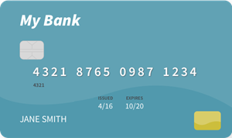
Types of Accounts
Two types of accounts are Checking and Savings accounts
Checking Accounts
Used for Day-to-Day Spending
Typically Don’t Earn Interest
Can Get / Use a Debit Card
Savings Accounts
Earn Interest
Typically Don’t Get a Debit Card
Not Used for Day-to-Day Spending
Notes:
CHECKING ACCOUNTS
Checking accounts are for money you spend day-to-day.
Banks provide checks so you can use your money without using cash.
Checking accounts give you greater access to your money.
Checking accounts usually don’t earn interest.
SAVINGS ACCOUNTS
Earn Interest
Typically Don’t Get a Debit Card
Not Used for Day-to-Day Spending
NOTES – Before you and your parent or guardian heads to the bank, be sure to ask what information they require.
Both are safe, convenient ways to get cash, make deposits, and transfer funds.

Slide 6
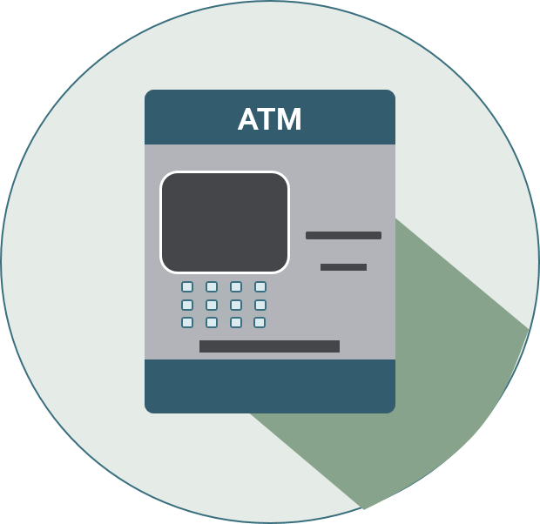
Manage Your Money – ATMs
BENEFITS
Easy access to cash
View your balance
RISKS
Fees – Watch out for withdrawal fees
Could lose or share your PIN
Could leave your card in the ATM
Notes:
Talk about ATMSs and what their benefits, including:
Easy access to cash
View your balance
Talk about some of the risks of using an ATM
Fees. Watch out for withdrawal fees at an ATM that’s not with your bank
Memorize your PIN. If you write the PIN Number down, leave it at home
Could leave your card in the ATM
Someone could see your account information
Tell the participants to be careful when using a card at an ATM

Slide 7
Manage Your Money – Apps
BANKING APPS ARE GREAT FOR:
BANK APP
Account Access / Management
Budgeting
Transferring Money
Digital Wallet (Apple Pay, Google Pay, Samsung Pay etc.)
Payments
Notes:
Talk about Banking Apps and what their benefits, including:
Account Access – most banks, credit cards and other financial companies have apps that you can use to access and manage your money
Budgeting – there are budgeting tools and apps available
Transferring Money – transferring money can be easy if you have the right app. There are a lot of apps out there that allow you to transfer money
Digital Wallet – apps can be used as a digital wallet. Apple pay can be used in place of credit cards.
Payments – apps make it easy to make payments

Slide 8
Deposit Money
What does the term deposit mean?
How do you put money into the bank?
Notes:
Ask the participants about the following and see if anyone can answer the questions.
What does deposit mean?
Deposit means to put something in. In this case, money into the bank.
Do you know how to put money into the bank?
You can use a deposit slip at the bank or put cash / checks into an ATM.

Slide 9
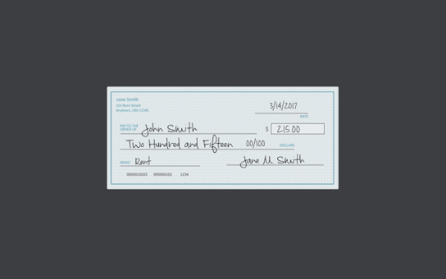
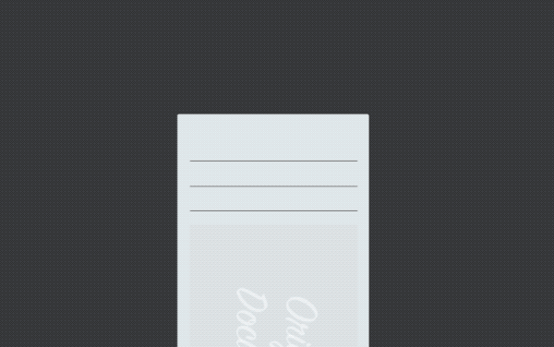
Depositing Money - Mobile
Using your Phone to Make a Deposit to Your Checking Account
STEP 5
STEP 3
STEP 4
STEP 1
STEP 2
STEP 6
Take a Picture of the Front of the Check
Take a Picture of the Back of the Check
Select the Deposit Option and Enter the Check Amount
Confirm Your Deposit
Sign the Back of the Check
Open Your Banking App
and Login
Notes:
Click through the steps in making a $40 deposits into an ATM. Follow the steps to deposit $40 in your savings account.

Slide 10
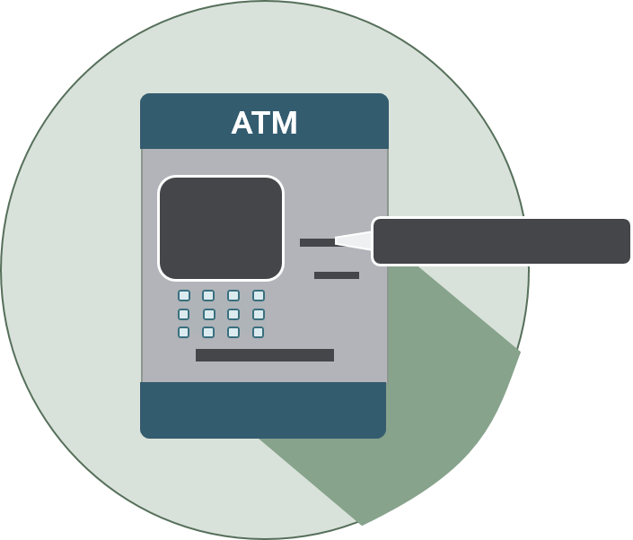
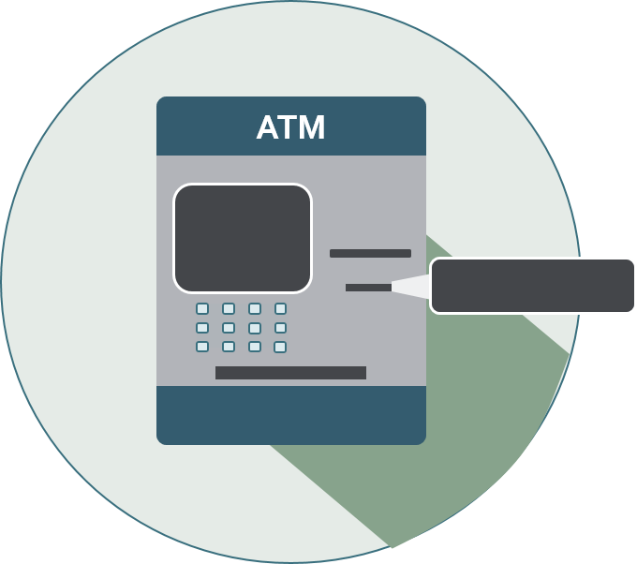
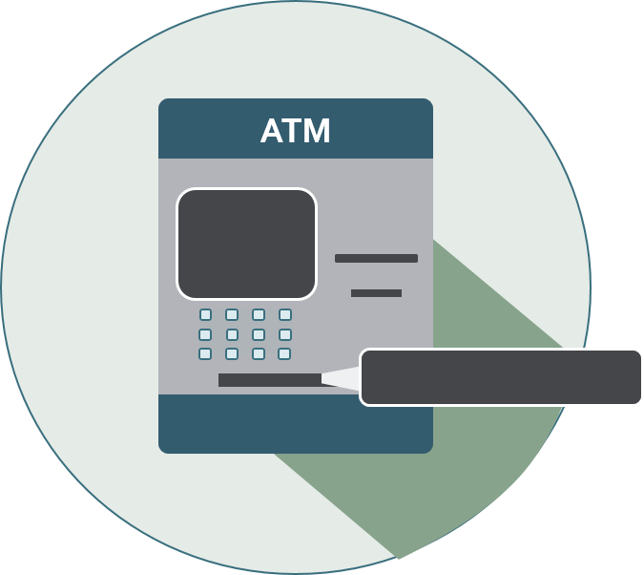
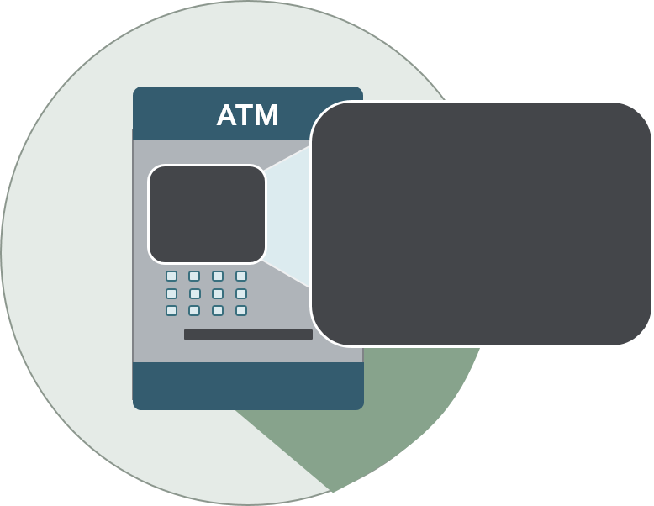
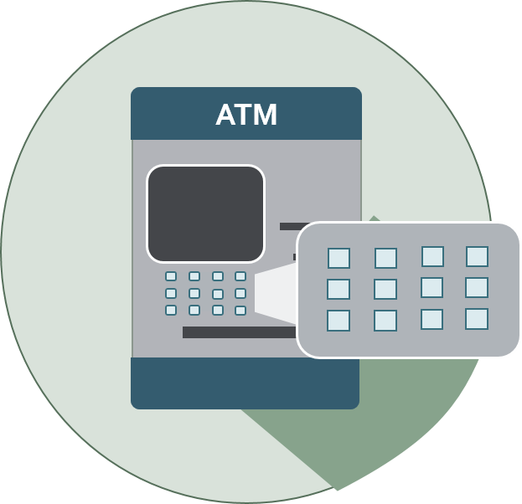
Depositing Money - ATM
Using the ATM to Make a Deposit to Your Savings Account
STEP 6
STEP 2
STEP 4
STEP 1
STEP 3
STEP 5
PUT YOUR ATM CARD IN THE CARD SLOT
USE THE KEYBOARD TO ENTER $40 AND PRESS ENTER
USE THE KEYBOARD TO ENTER YOUR ATM PIN
TAKE YOUR ATM CARD AND THEN YOUR RECEIPT
PUT THE CASH OR CHECKS INTO THE DEPOSIT SLOT
SELECT DEPOSIT, THEN SAVINGS ON THE SCREEN
Notes:
Click through the steps in making a $40 deposits into an ATM. Follow the steps to deposit $40 in your savings account.

Slide 11
Withdrawing Money
What does the term withdrawal mean?
How do you take money out of a bank?
Notes:
Ask the participants about the following and see if anyone can answer the questions.
What does withdrawal mean?
Withdrawal means to take something out. In this case, money from the bank.
Do you know how to take money (withdrawal) out of the bank?
You can use a withdrawal slip at the bank or use an ATM / Debit Card to take out cash from an ATM.

Slide 12
Quiz Time!
Question 1
Question 3
Question 2
ANSWER : Overdraft and Overdraft Fees
What can happen if I buy something with my debit card that is more than what I have in my checking account?
What does 'available balance' mean?
What is the best way to avoid spending more money than I have in my account?
ANSWER : The amount of money in your account that you can use for purchases and withdrawals.
ANSWER : Create a budget and track your spending.
Notes:
Review the quiz questions and answers with participants:
QUESTION 1 – What does ‘available balance’ mean?
ANSWER – The total amount of money in your account that you can use for purchases and withdrawals.
QUESTION 2 - What is the best way to avoid spending more money than I have in my account?
ANSWER – Create a budget and track your spending.
QUESTION 3 – What can happen if I buy something with my debit card that is more than what I have in my checking account?
ANSWER – Overdraft and Overdraft Fees

Slide 13
Wrap-up / Q&A
What Banks Do
Types of Accounts
Getting to Your Money
ATMs
APPS
Depositing Money
Withdrawing Money
QUESTIONS?
Notes:
Review the following key points about shopping with a budget:
What Banks Do
Types of Accounts
Getting to your money
ATMs
Apps
Depositing Money
Withdrawing Money

Slide 14
Thank You / Feedback

Slide 15
Thank You / Feedback Request
Thank you for your support and commitment to providing financial education within our communities! To demonstrate our impact with the work you do, we are collecting volunteer and educator feedback.
Please go to the following page to enter feedback - https://handsonbanking.org/volunteerfeedback/.
Please have your participants go to the following webpage to submit their feedback - https://handsonbanking.org/participant-survey/.
The evaluation does not contain any personal information for participants or you. The evaluation will help us understand participants’ knowledge and confidence about money management topics and will help us better demonstrate the impact of our efforts.
Notes:
After class:
Take a few minutes to ask the teacher or program director how they thought the lesson went. Ask if there are other materials or information you could provide them.
Consider writing a thank you note as a follow-up to your visit.
Submit feedback on your experience at https://handsonbanking.org/employee-volunteer-feedback/
Go to https://wellsfargo.yourcause.com/ and record your volunteer hours.

