Slide 1
Budgeting and Saving
BEFORE PRESENTING THIS MATERIAL:
ADD YOUR NAME TO THE FIRST PAGE
PRACTICE THE PRESENTATION FOR TIMING
REVIEW PRESENTER NOTES TO BECOME FAMILIAR WITH THE INFO / SLIDES
PUT PRESENTATION INTO ‘SLIDE SHOW’ MODE TO CLICK THROUGH THE PRESENTATION AND USE THE INTERACTIVE ELEMENTS.
DELETE THIS MESSAGE BEFORE PRESENTING.
Presenter Name
Notes:
NOTE: When conducting a Hands on Banking financial education volunteer presentation, you cannot promote any specific Wells Fargo products or services during your presentations.
LESSON CONCEPT – Managing expenses while staying within budget
LESSON OBJECTIVE – Participants have the opportunity to see how budgets allow individuals to balance their expenses with their income. Students will do simple calculations involving percents, and identify the steps to making good financial decisions.
MATERIALS NEEDED
For you:
Personal Computer
Internet Access
Projector
PowerPoint Presentation
Participant
Tablet / Computer with Internet Access (optional)
Handouts
Giveaway Items (optional items ordered from the DUC)
INTRODUCTION
Introduce yourself to the class. Share with them what your role is at Wells Fargo.
Share with the class what you’ll be covering today:
Understand the difference between needs and wants
Become familiar and practice personal budget basics
Understand the value of tradeoffs
Have fun!
Any questions before we begin?

Slide 2
Introduction
Have you ever wanted to buy something and did not have enough money?
How could you have saved money to get it?
It’s all about making choices!
Notes:
Start the lesson with the following opening questions:
Think about a time when you wanted to buy something but did not have enough money to pay for it. Examples: Video games, scooter. Ask the students to share their answers.
If you really wanted this item, how could you have saved money to pay for it?
What are examples of something you or your family need to buy—versus something you’d like to have? For instance, we need a refrigerator, but we’d really like to have an 80” flat screen TV.
Share the following key points to help students further understand Needs vs. wants concepts:
Every month, adults have things they have to pay for, for example a place to live, food, and transportation. There are also things they would like to spend money on just for fun! All of these costs are called monthly expenses.
Most people have a limited amount of money available, so we have to make choices about how to spend our money. We need to make decisions based on whether we need something, or just want it.

Slide 3
Video – Budgeting Overview
Notes:
Watch the video with participants to give a quick overview of what a budget is.
Budgeting is a great way to track your spending and saving. Creating a budget, or spending plan, may seem overwhelming or tough, but it can be done. Start by tracking your expenses. This will give you a good idea of what you are spending your money on, how much you are spending, and when you are spending it.
You can simplify your budget by considering your needs and wants. You also want to make sure your budget is helping you reach your financial goals. The example below shows you one way to develop a budget.

Slide 4
Needs vs Wants
Needs
Wants
Food
Shelter
Clothes
Transportation
Candy
Video games
Phone apps
Movies with your friends
Notes:
Share the following key points:
To be a good money manager you need to distinguish between needs and wants.
One person’s needs and wants may be very different from another's, but in general, needs are items or activities you must have in order to live.
Wants are things you would like to have or do, but that you could live without.
This is why having a budget and a savings plan is so important.

Slide 5
A Written Plan
A written plan for using your money
Needs First
Wants Second
Saving Money the Smart Way
Pay Yourself First
Notes:
Share the following key points:
It is important to create a written plan for how you use your money
Budget lets you plan how to spend your money.
It’s like having a road map when you travel with a GPS—keeps you going in the right direction.
Buy the things that you need first—and if there’s money left over, you can save for the things you want!
This is called making a budget—a written plan for using your money.
Having a budget puts you in control of your money, and it allows you to save for the fun items you want.
It’s also important to factor savings into your budget. Putting money aside or paying yourself first is a good way to build savings – whether for something you need soon or in the future.

Slide 6
Income and Expenses
Know your income and expenses
Income
Allowance
Money earned from taking care of your neighbor’s dog
Helping your parents with house chores
Expenses
Lunch
Snacks
Apps / Video Games
Movies
Clothes / Shoes
Notes:
Briefly describe income and expenses and provide the examples noted on the slide. Ask for additional examples from the class.
What are some other examples of items you would consider to be income and expenses that are not listed on this slide?
Why would identifying your personal income and expenses be important to you when creating your own personal budget?
Note: These open-ended questions should create more clarity when students are working on the budget worksheet.

Slide 7
Be Prepared to Make Tradeoffs
Making tradeoffs is about choosing not to buy one thing in order to buy another
…making tradeoffs isn’t always easy.
Notes:
Share the following key points:
Even when you have a budget in place you may still need to consider tradeoffs.
If you don’t have enough money to buy everything you need and want, you may have to make tradeoffs. This means choosing not to buy one thing in order to have enough money to buy another.
Before you go out to buy something, ask yourself the following questions and be ready for tradeoffs!
Is it something you need or is it something you want?
Is it cheaper at another store?
Is there something similar that’s cheaper and you can live with instead?
Is there a better way to spend your money?
How can you budget your money to afford what you want?
Ask for a volunteer who is willing to share their example of tradeoff with the class.
Ok, now are you ready to try a budget activity?

Slide 8
Activity
Let’s practice a budget activity!
Your weekly budget
Description | Income (+) | Expense (-) | $ Available
Allowance
$20.00
$20.00
Snacks
$5.00
$15.00
Movie
$7.00
$8.00
App
$3.00
$5.00
Notes:
Click through the budget and spending with the participants. Make sure they can track and understand how much money is left in their bank accounts once some money is spent.

Slide 9
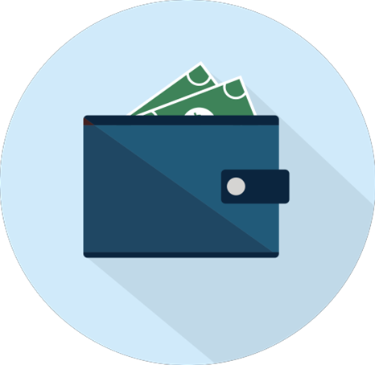
Saving
Saving is a key part of reaching financial independence and building wealth.
Think of saving as giving a gift, or paying a reward, to yourself.
The money you save gives you so many benefits, like having cash in an emergency. It can also give you the ability to buy big things, like a car.
Notes:
Review the following details of Saving:
Saving is a key part of reaching financial independence and building wealth.
Think of saving as giving a gift, or paying a reward, to yourself.
The money you save gives you so many benefits, like having cash in an emergency. It can also give you the ability to buy big things, like a car.
Remember that building up huge amounts won’t happen overnight. But it can happen if you make saving a habit, make it automatic, and stick with it over time.

Slide 10
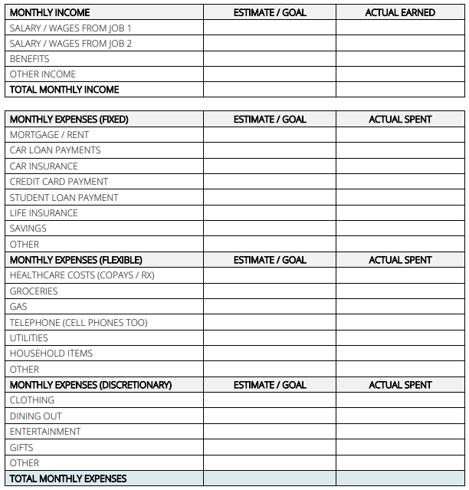
Spending Plan
An easy way to track your spending is to keep a log of everything you spend in a spending plan. A spending plan contains:
Money received, especially on a regular basis, for work or through investments.
Income
Expenses - Fixed
Fixed expenses are those that remain constant within your budget.
Expenses - Flexible
Flexible expenses are items you need, but the amount can change month over month.
Expenses - Discretionary
Total Monthly Expenses
Discretionary expenses are flexible expenses that you can live without.
Notes:
Creating a spending plan is an easy way to track your spending.
With a spending plan after you’ve added up all of the your Income and Expenses, subtract your Expenses from Income. This is called Net Income. If the number is positive it means you have leftover money at the end of the month. If it’s negative, then you spent more than you earned. With a positive net income, you can use the extra money to get out of debt, pay off loans or increase your savings.
At the end of the month look over the log and ask yourself a few questions:
What expenses make me proud or happy?
What expenses would I reconsider?
Can I organize my spending into larger categories?
What categories did I spend the most money on?
Are there expenses or items that I can cut out of my budget or spend less on?
What changes should I make given my goals and spending habits?

Slide 11
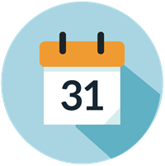
Tips to Save More
MAKE SAVINGS A HABIT
PAY YOURSELF FIRST!
SET ASIDE EXTRA MONEY
PAY YOUR BILLS ON TIME
SET SAVINGS TARGETS / GOALS
Even $5 or $10 a month can help you get into the habit of saving! If you can set aside $25 per month, you will have $300 saved up by the end of the year. Seeing your savings grow helps to motivate you to save more.
Notes:
Go over the items / tips to saving more. Emphasize the comment below about saving even a little can add up to a lot.

Slide 12
Quiz Time!
Question 3
Question 1
Question 2
What can happen if I buy something with my debit card that is more than what I have in my checking account?
What is the best way to avoid spending more money than I have in my account?
What does 'available balance' mean?
ANSWER : The amount of money in your account that you can use for purchases and withdrawals.
ANSWER : Create a budget and track your spending.
ANSWER : Overdraft and Overdraft Fees
Notes:
Review the quiz questions and answers with participants:
QUESTION 1 – What does ‘available balance’ mean?
ANSWER – The total amount of money in your account that you can use for purchases and withdrawals.
QUESTION 2 - What is the best way to avoid spending more money than I have in my account?
ANSWER – Create a budget and track your spending.
QUESTION 3 – What can happen if I buy something with my debit card that is more than what I have in my checking account?
ANSWER – Overdraft and Overdraft Fees

Slide 13
Wrap-up
Budgeting is creating a plan for how to use and save your money.
Know the difference between needs vs. wants
Plan how you spend and save your money
Think twice before buying. Ask yourself: “Do I really need it?”
Learn to make tradeoffs.
Creating a budget is easy!
Saving is a key to reaching financial independence and building wealth.
The money you save gives you so many benefits, like having cash in an emergency.
What did you learn about today?
Notes:
Review the following key points about shopping with a budget:
Budgeting means creating a written plan for how to use your money. It’s easy.
Today we focused on planning what you can afford to buy when you go shopping. We saw that if you don’t have enough money to buy everything you need and want, you may have to make tradeoffs. This means choosing not to buy one thing in order to have enough money to buy another. Making tradeoffs isn’t always easy.
You can create a budget to track all of your money. You write down on paper how much money you have coming in, and what you will spend on a weekly or monthly basis.
Budgeting your money helps to ensure you can pay for all of your needs before you spend on your wants. It can help you identify items that cost too much and to prepare for future expenses.
Each person’s needs and wants are a little different, so create a budget that makes sense for you.
Go over the importance of Saving with the participants.
Ask if there are any questions about what was covered today, or any other questions about how they can manage their money.
Ask the students: What is one thing you learned today about budgeting?

Slide 14
Thank You / Feedback

Slide 15
Thank You / Links to Feedback Forms
Thank you for your support and commitment to providing financial education within our communities! To demonstrate our impact with the work you do, we are collecting volunteer and educator feedback.
Please go to the following page to enter feedback - https://handsonbanking.org/volunteerfeedback/.
Please have your participants go to the following webpage to submit their feedback - https://handsonbanking.org/participant-survey/.
The evaluation does not contain any personal information for participants or you. The evaluation will help us understand participants’ knowledge and confidence about money management topics and will help us better demonstrate the impact of our efforts.
Notes:
After class:
Take a few minutes to ask the teacher or program director how they thought the lesson went. Ask if there are other materials or information you could provide them.
Consider writing a thank you note as a follow-up to your visit.
Submit feedback on your experience at https://handsonbanking.org/employee-volunteer-feedback/
Go to https://wellsfargo.yourcause.com/ and record your volunteer hours.

